Slide 1
Chinook Music Album Database
Online Music Store
MySql

Slide 2
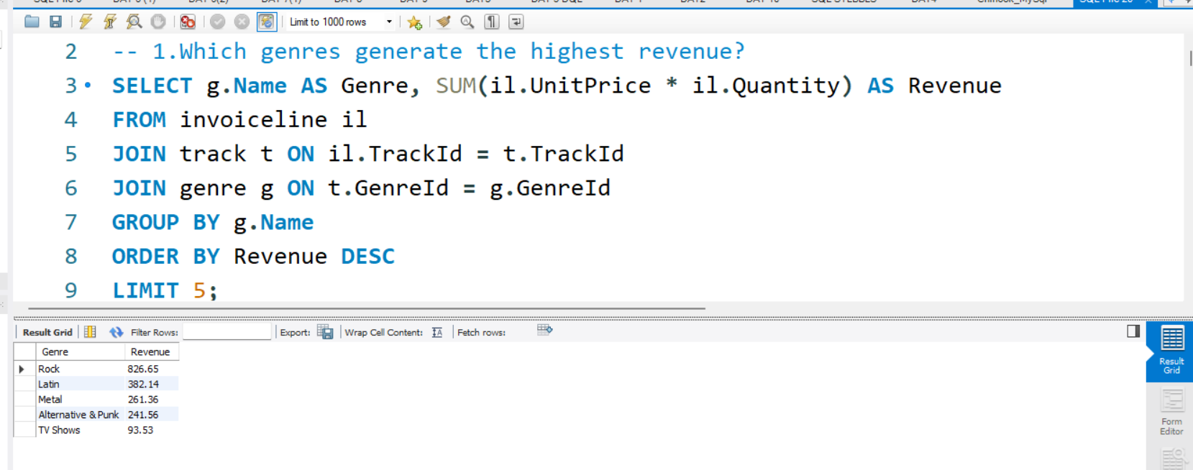
Top – Selling Genres
This query calculates total revenue for each genre by joining
InvoiceLine, Track, and Genre. It helps identify which music genres are most profitable

Slide 3
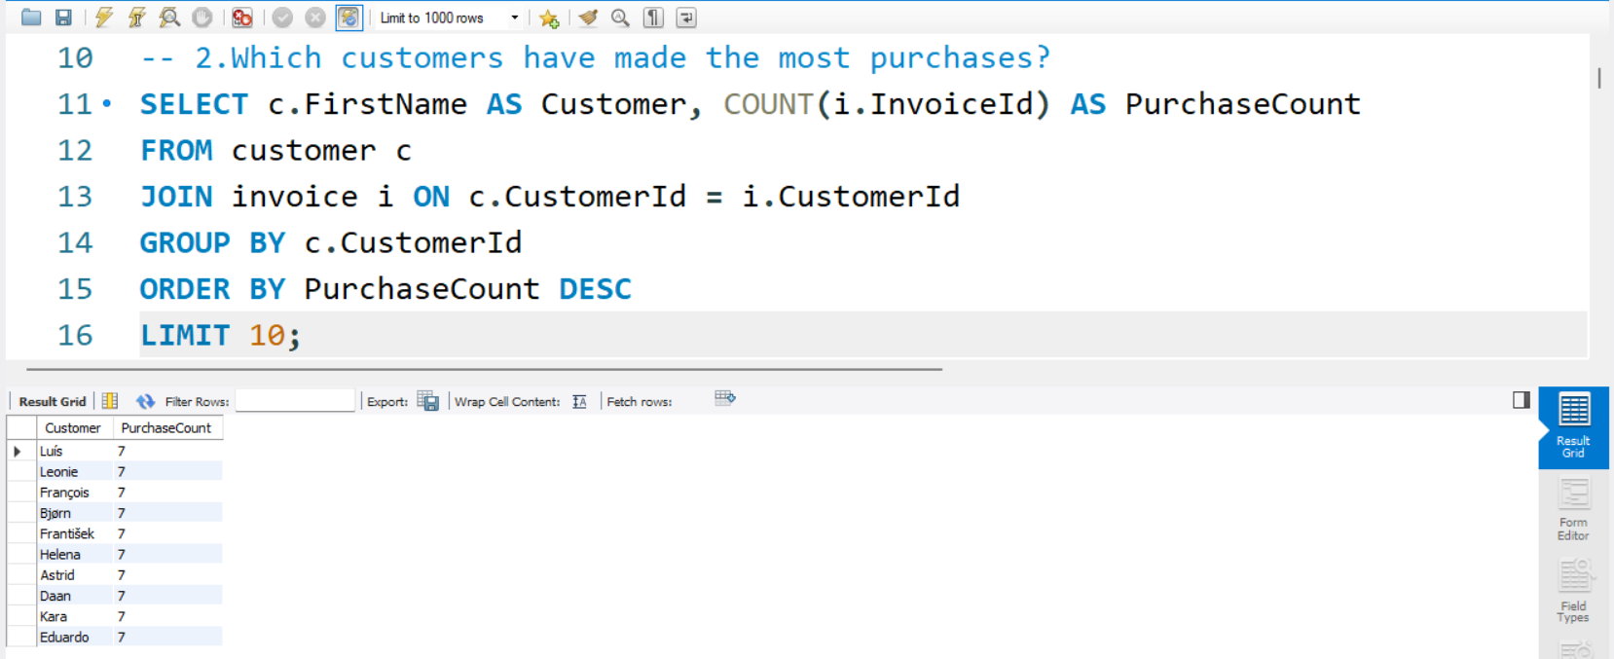
Most Active Customers
Counts how many invoices each customer has made. Useful for spotting loyal or frequent buyers.

Slide 4
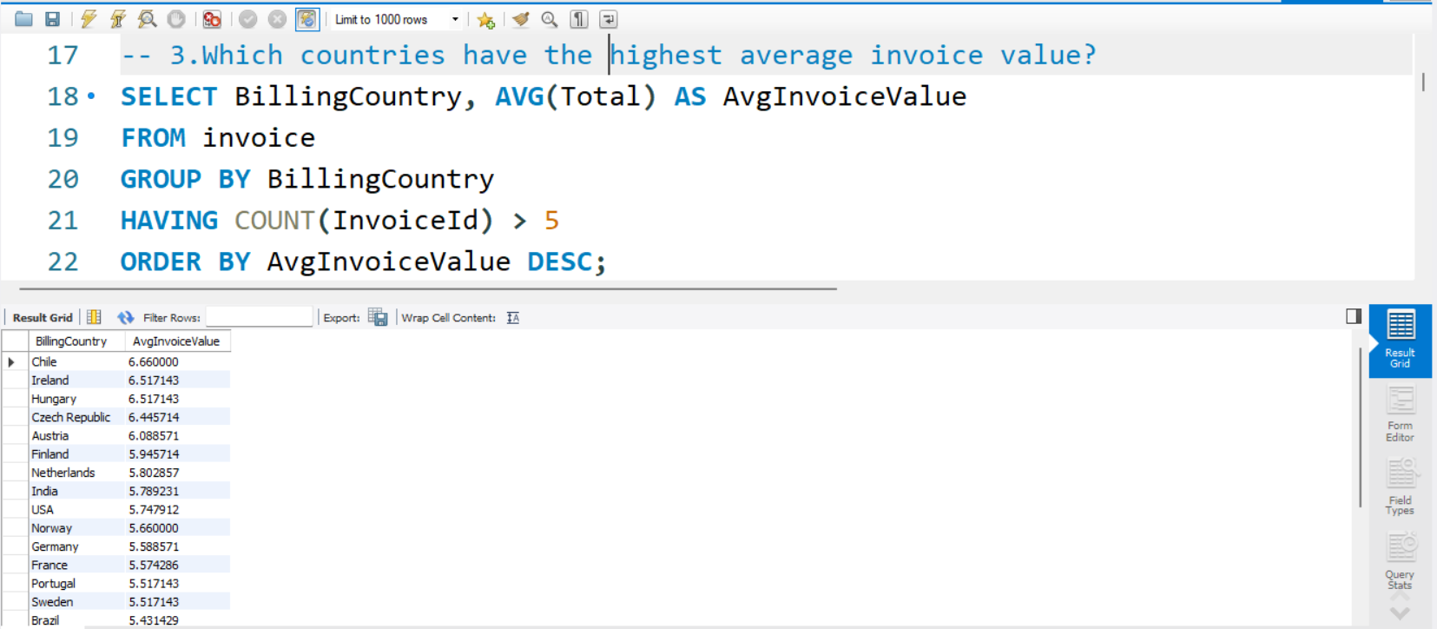
Average Invoice Value by Country
Calculates the average invoice total per country. Helps compare purchasing power across regions.

Slide 5
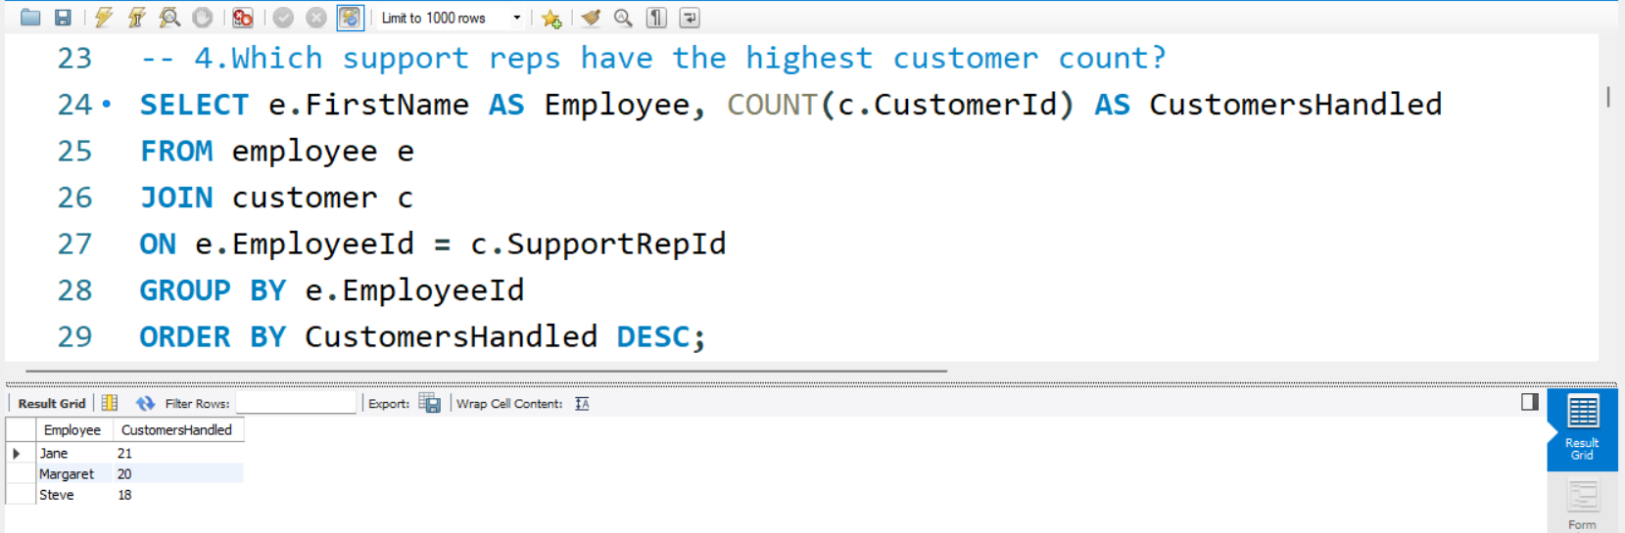
Employee Performance
Shows how many customers each support rep handles. Useful for workload distribution and performance review.

Slide 6
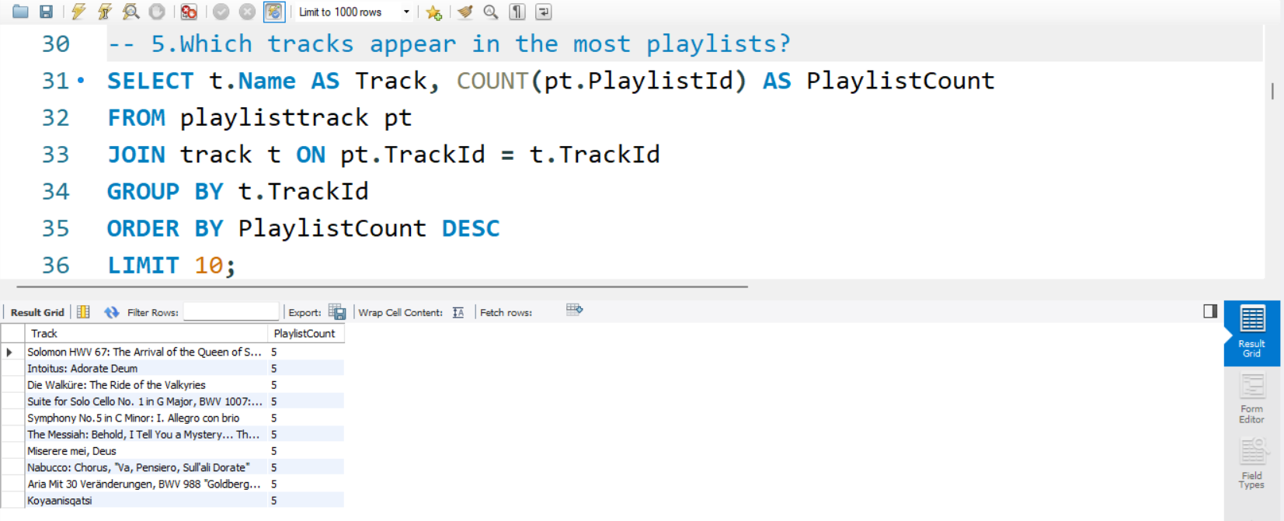
Track Popularity by Playlist
Counts how often each track appears in playlists. Highlights popular or frequently curated songs.

Slide 7
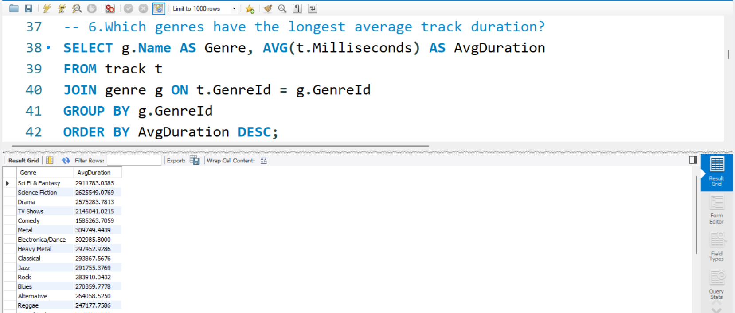
Longest Tracks by Genre
Finds genres with the longest average track duration. Useful for understanding genre characteristics

Slide 8
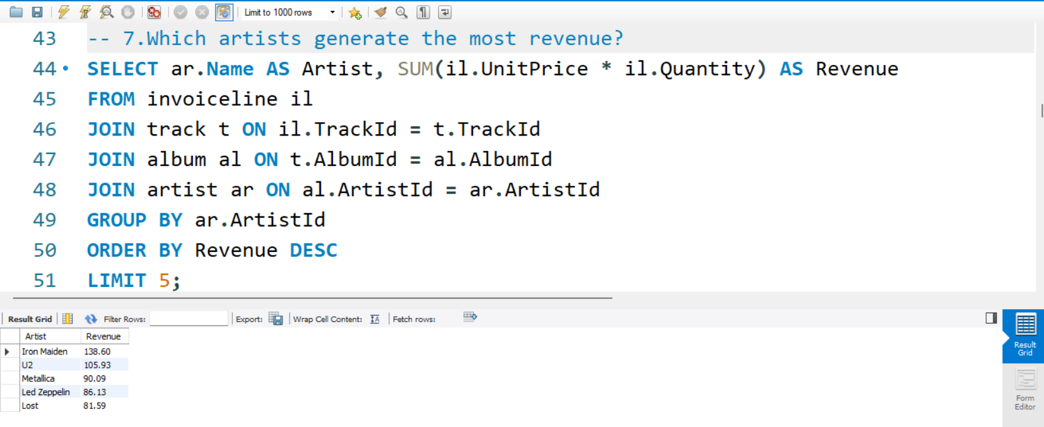
Top Artists by Revenue
Calculates total revenue per artist by tracing sales through albums and tracks. Identifies top earners

Slide 9
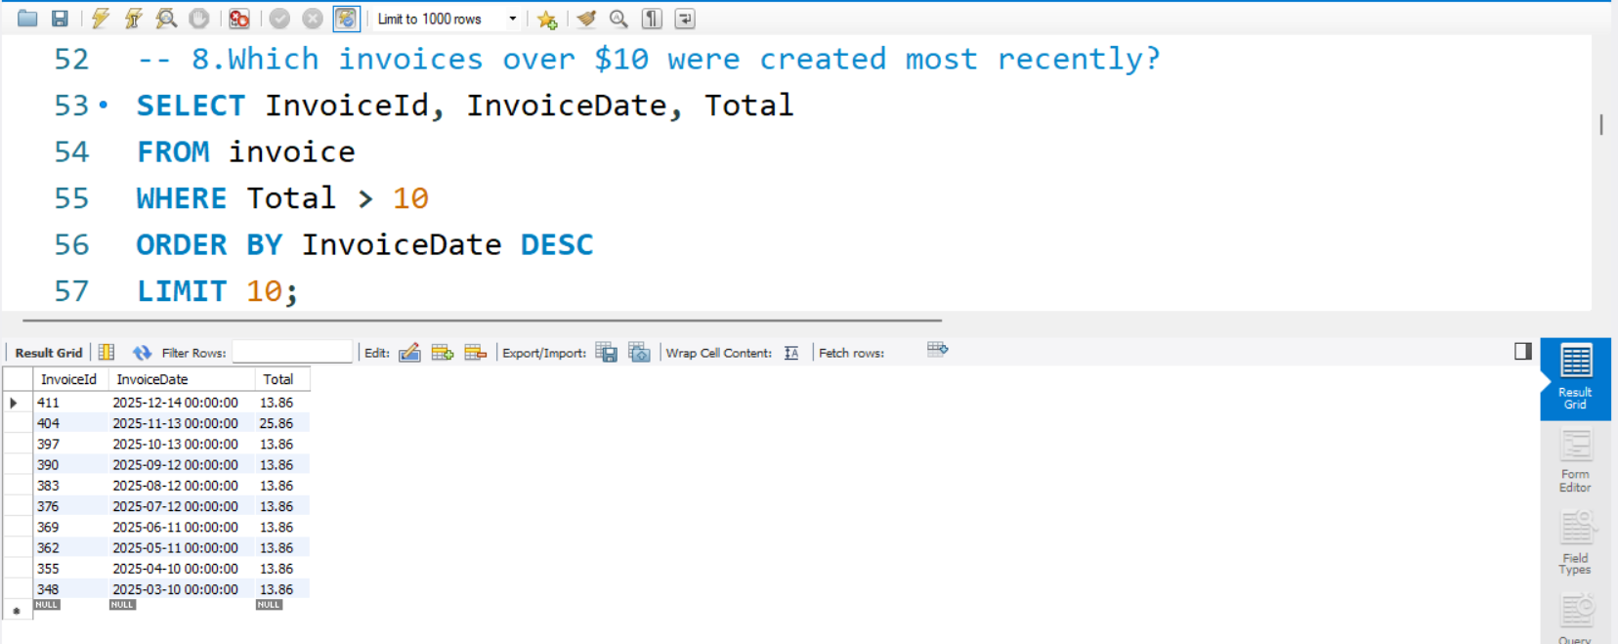
Recent High-Value Invoices
Lists invoices over $10 sorted by date. Helps track recent big purchases.

Slide 10
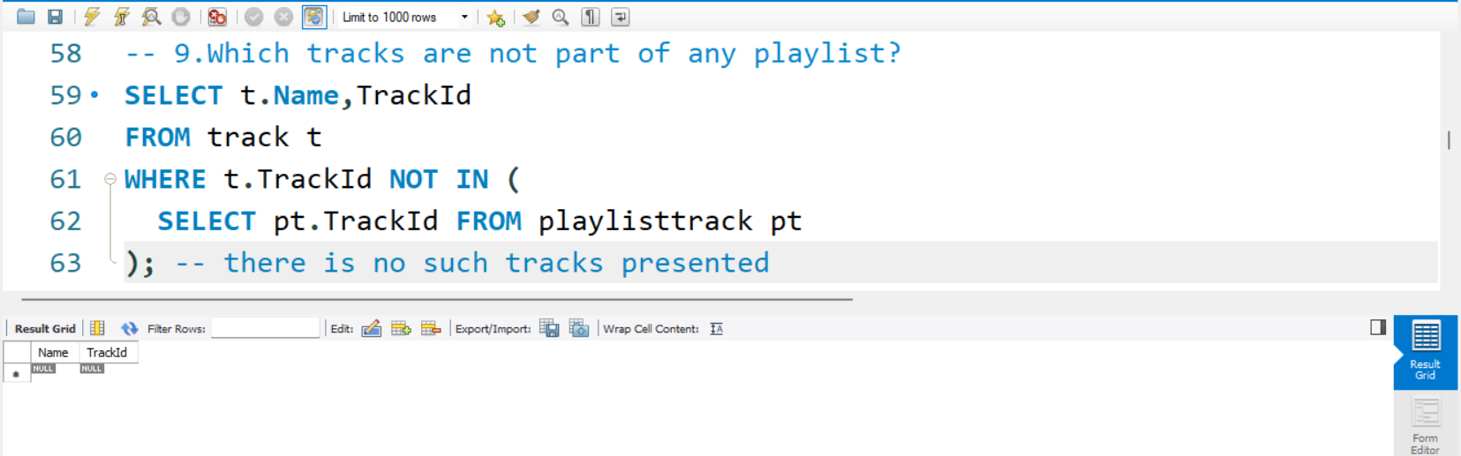
Tracks Not in Any Playlist
Finds tracks that haven’t been added to any playlist. Useful for identifying underused or hidden content.

Slide 11
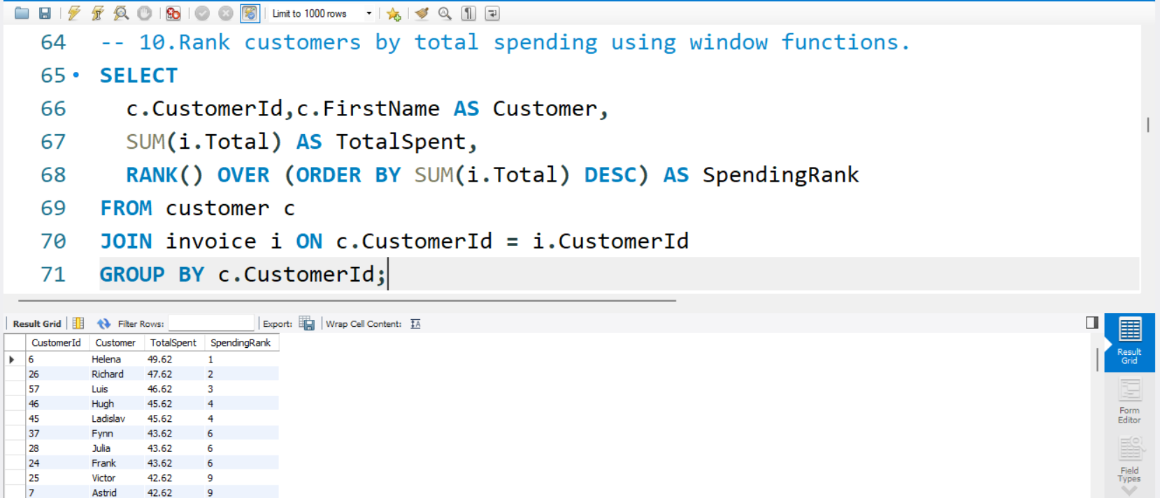
Customer Spending Rank
Ranks customers by total spending using window functions. Useful for identifying premium customers.

Slide 12
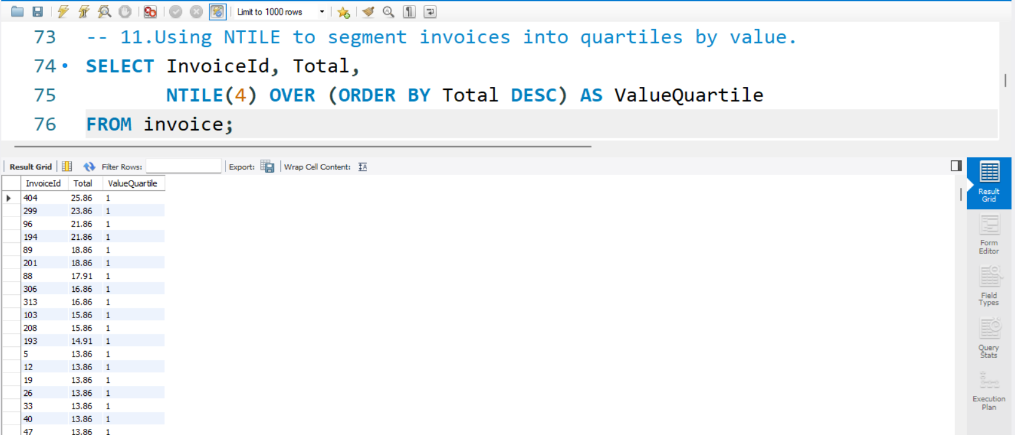
Invoice Value Distribution
Segments invoices into quartiles using NTILE. Helps analyze spending patterns.

Slide 13
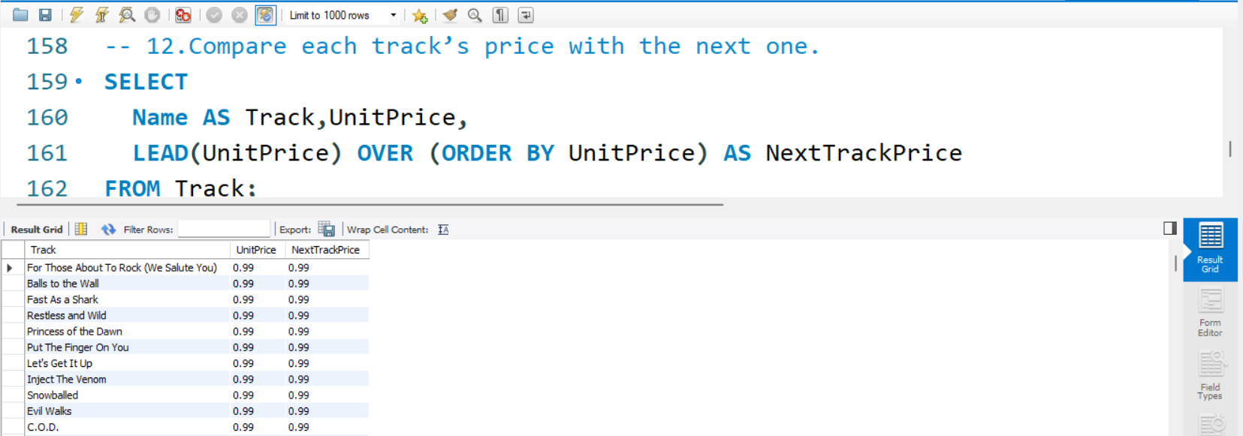
Track Price Trend
LEAD() shows the price of the next track in order. Helps analyze pricing gaps or trends

Slide 14
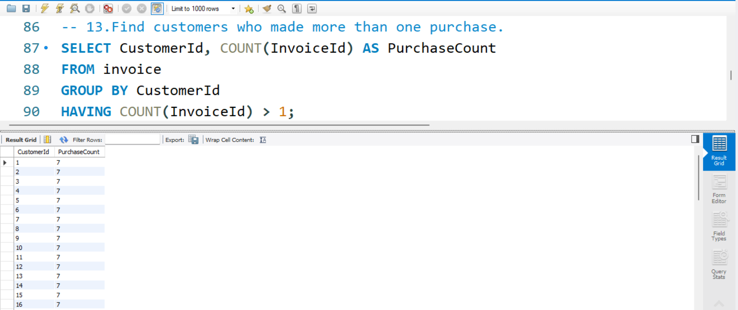
Customer Retention Insight
Identifies customers with more than one purchase. Useful for retention and loyalty analysis.

Slide 15
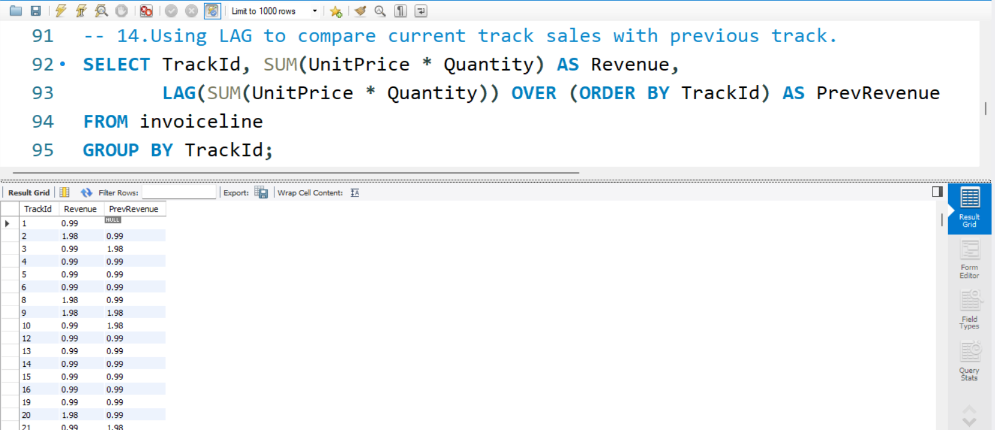
Track Sales Lag
Compares each track’s revenue with the previous one using LAG. Helps spot sales trends.

Slide 16
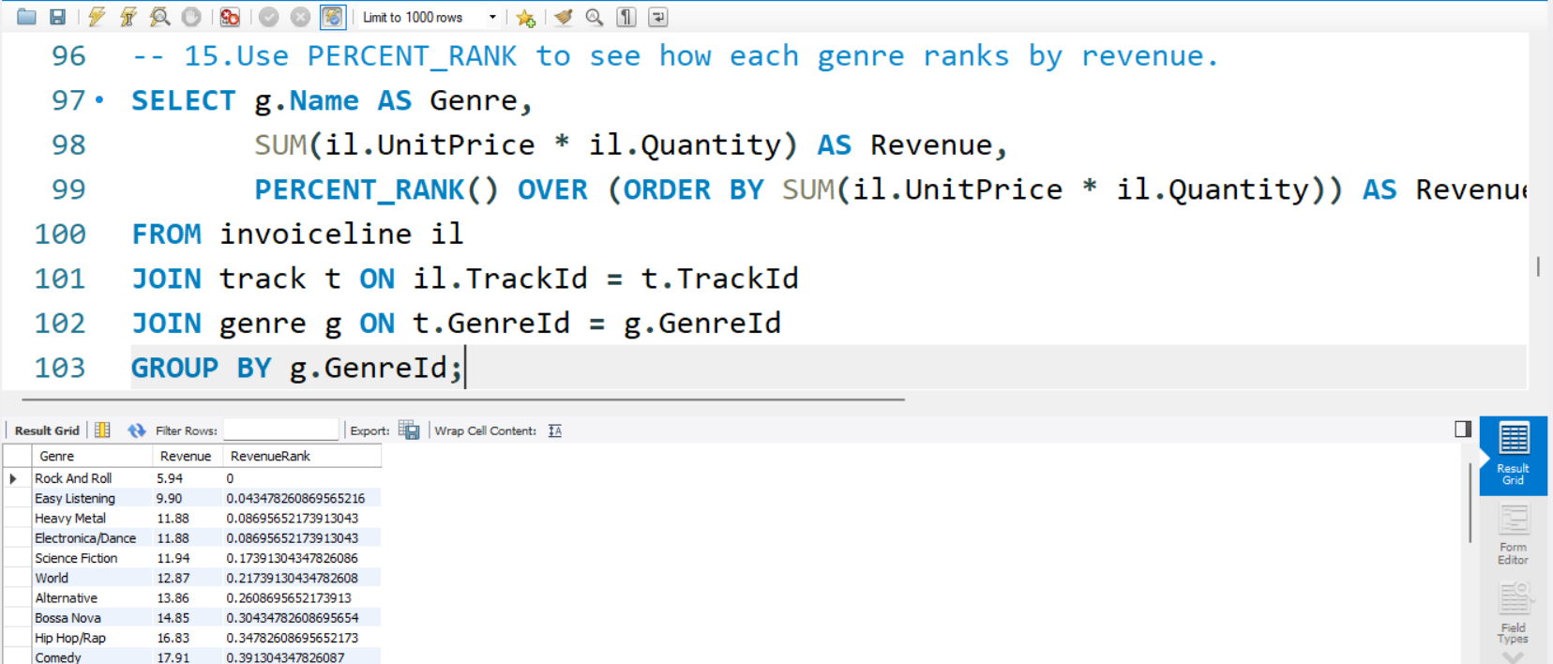
Genre Revenue Percent Rank
Ranks genres by revenue using PERCENT_RANK. Useful for performance comparison.

Slide 17
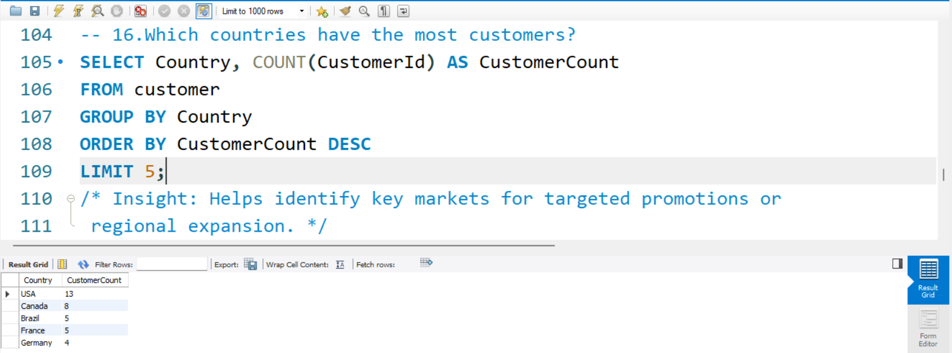
Top Countries by Customer Count
Counts customers per country. Helps identify major markets.

Slide 18
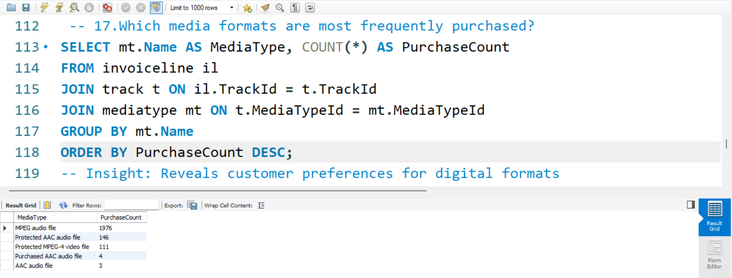
Most Common Media Types
Shows which media formats are most purchased. Useful for format preference analysis.

Slide 19
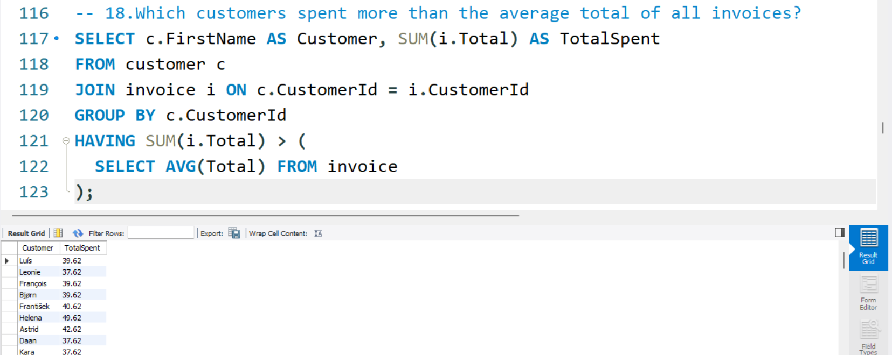
High-spending Customers
Finds customers who spent more than the average. Helps identify premium buyers.

Slide 20
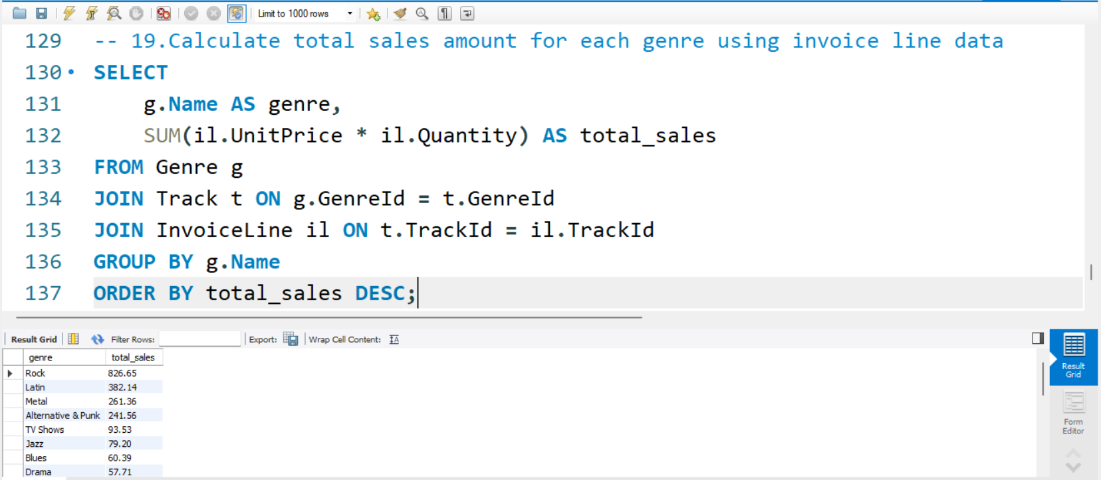
Total Sales by Genre
Calculates total sales per genre using joins and aggregation. Useful for genre-level revenue insights.

Slide 21
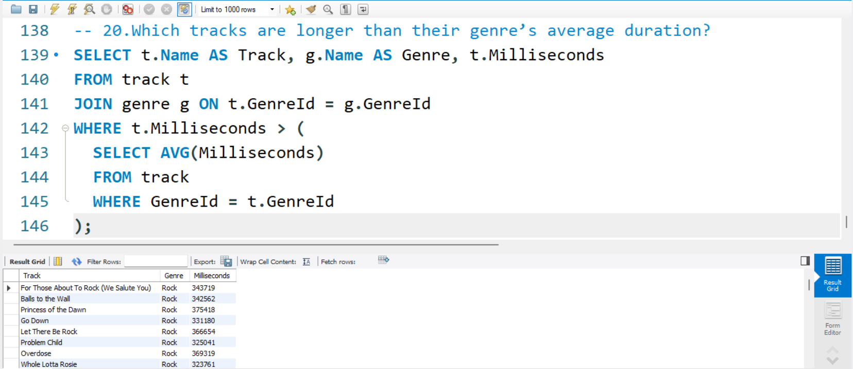
Tracks with Above-Average Duration by Genre
Lists tracks longer than their genre’s average. Useful for identifying standout or extended tracks.

Slide 22
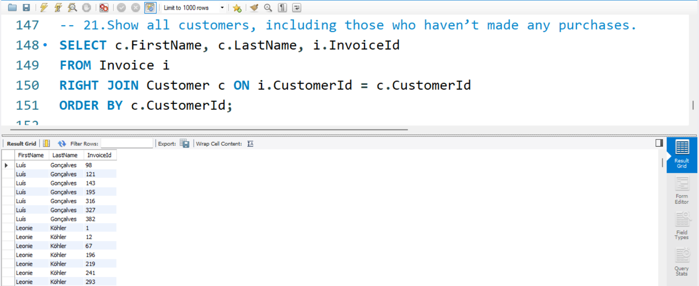
Customers Without Invoices
This query uses RIGHT JOIN to include all customers, even if they have no invoices. Useful for identifying inactive users

Slide 23
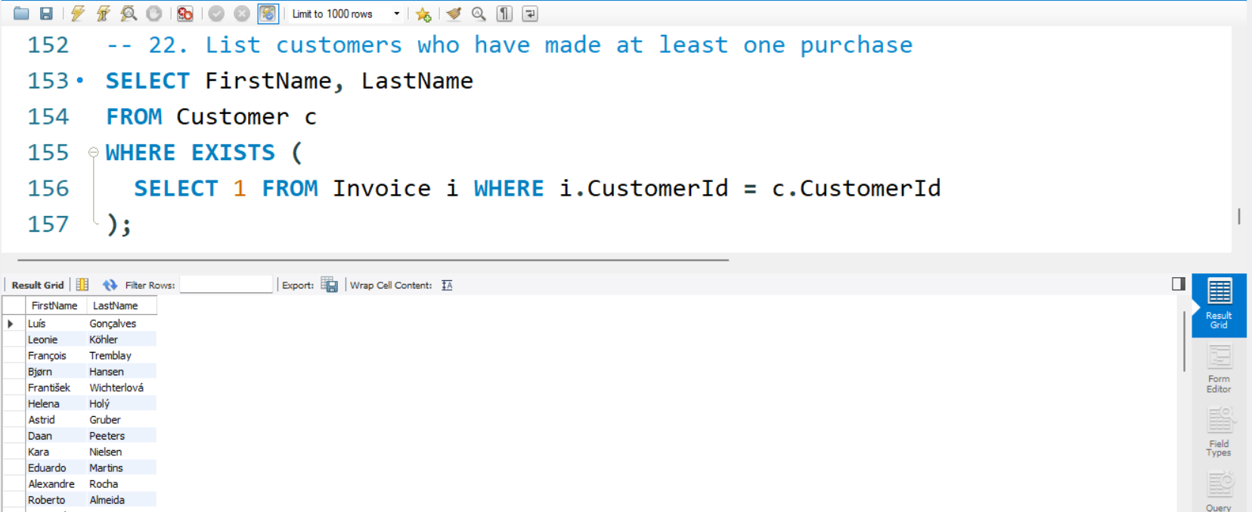
Customers Who made Purchases
Uses EXISTS to filter only those customers who have related invoices. Efficient for checking existence without counting

Slide 24
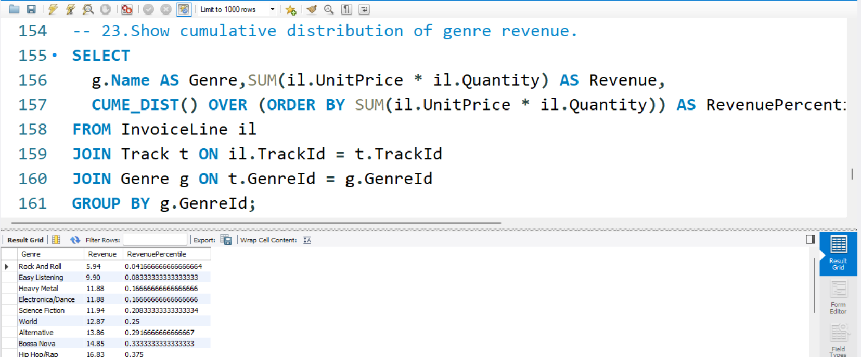
Genre Revenue Distribution
CUME_DIST() ranks genres by cumulative revenue percentile. Useful for percentile-based performance analysis

Slide 25
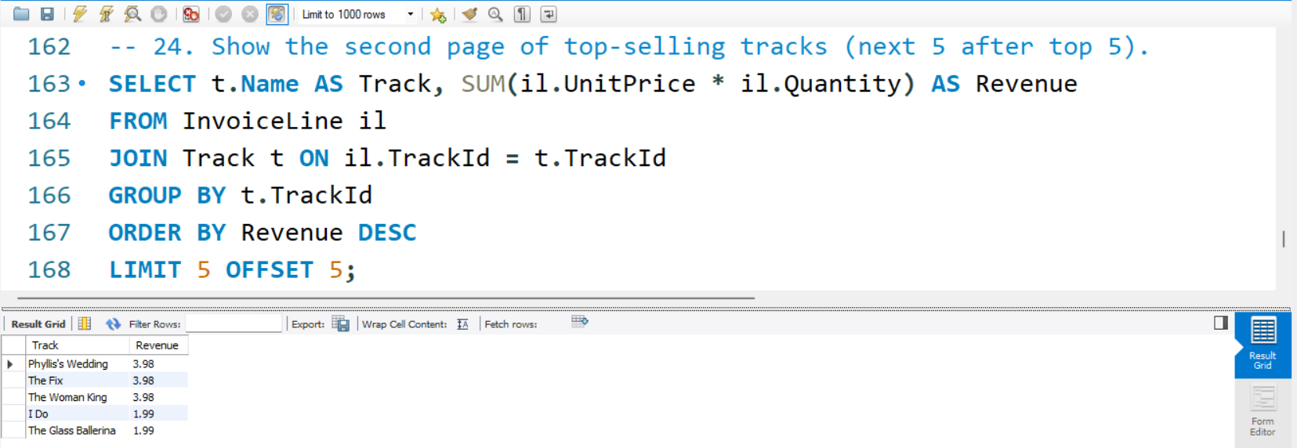
Paginate Top Tracks
OFFSET skips the first 5 results, showing the next set. Useful for pagination or browsing large result sets

Slide 26
Thank you
By
Dinesh S

